Slide 1

Directionality Characteristics of the Tympan Open-Source Hearing Aid and Earpieces
Benjamin P. Masters
Joshua M. Alexander

Slide 2
Methods
When possible, followed procedures outlined in ANSI/ASA S3.35-2021
“Method of measurement of performance characteristics of hearing aids under simulated real-ear working conditions”
Pink Noise Stimulus
≈85 dB SPL at hearing aid mic location
5-second duration
Analyzed in 1/3-octave bands

Slide 3
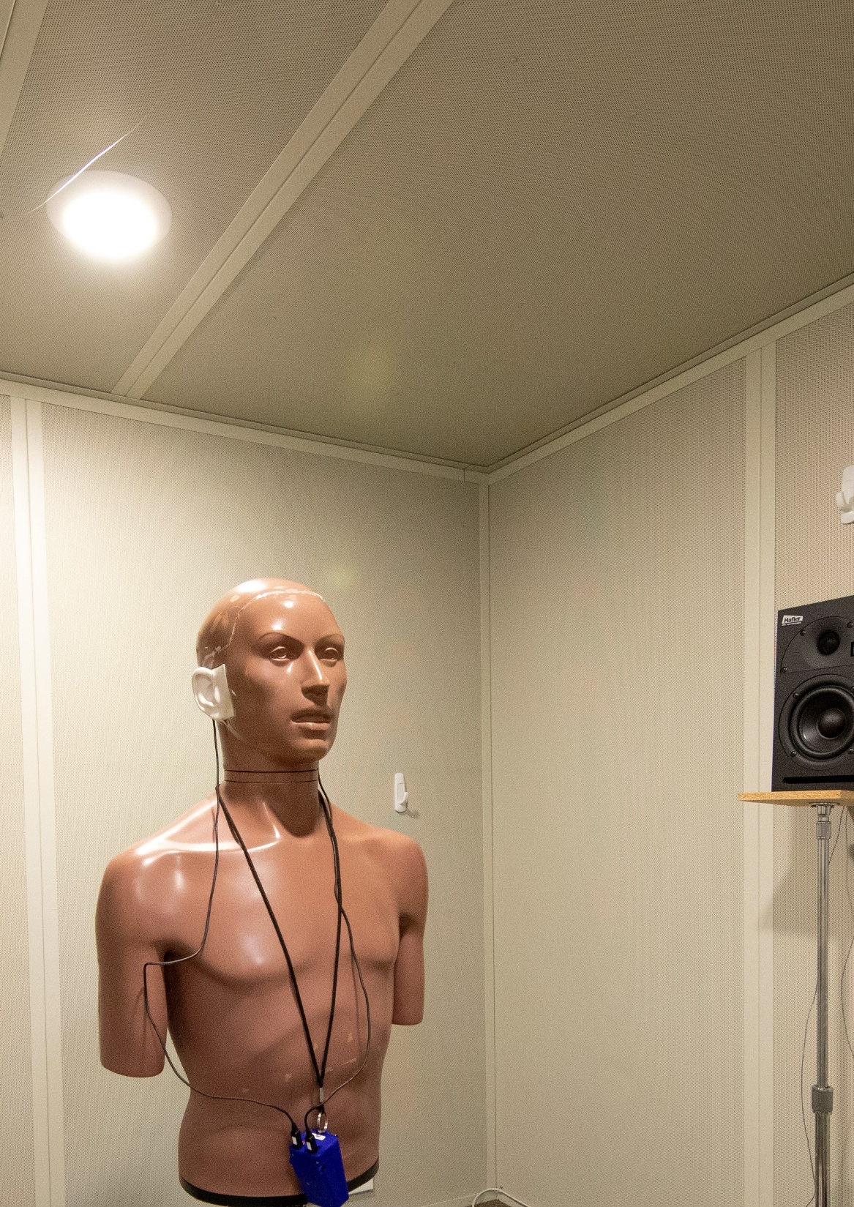
Set up
KEMAR centered in a double-walled sound booth (2.13 m x 2.44 m)
Rotated in 10° increments
Left earpiece was tested
Hafler M5 Reference Monitor sound field loudspeaker
Flat frequency response
Test ear
3

Slide 4
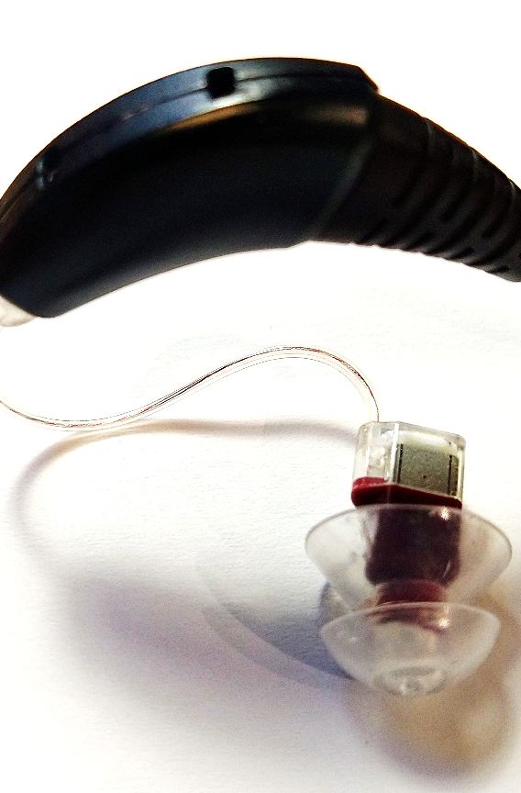
Earpieces
9.5 mm
27.7 μs
9.5-mm mic spacing (d)
c ≈ 343 m/s
Travel time (d/c): 27.7 μs
Sampling rate set to 36.1 kHz → 1-sample delay = d/c = 27.7 μs
Cardioid directivity
4

Slide 5
Microphone Matching
Critical for optimal cancellation
Rear mic output was ≈ 5 dB lower than the front mic
5 dB of gain was added to match the two mics

Slide 6
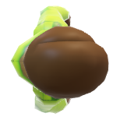
Omni-Directional Responses
It is well-known that putting mics on the head will shift the response to the side due to head shadow
Front Mic (re 0°)
Rear Mic (re 180°)
AIDI = -1.12
AIDI = -1.00

Slide 7

Rear Mic Delay
0° reference
-3 dB Rear Gain
0 dB Rear Gain
+3 dB Rear Gain
AIDI = +2.31
(+3.43)
AIDI = +0.50
(+1.62)
AIDI = -1.53
(-0.41)
*Gain values after mic matching
AIDI was lowest with -6 dB and +6 dB rear mic gain
AIDI = Articulation Index weighted Directivity Index values in () = Improvement re: front mic only

Slide 8
Front Mic Delay
180° reference
-3 dB Front Gain
0 dB Front Gain
+3 dB Front Gain
AIDI = +0.95
(+1.95)
AIDI = +2.98
(+3.98)
AIDI = -0.11
(+1.11)
*Gain values after mic matching
AIDI was lowest with -6 dB and +6 dB front mic gain
AIDI = Articulation Index weighted Directivity Index values in () = Improvement re: rear mic only

Slide 9
AIDI Improvement
Front mic with rear mic delay and gain = -3 compared to front mic only (0° reference)
Rear mic with front mic delay and gain = 0 compared to rear mic only (180° reference)

Slide 10
Future Directions: Variable Directionality
Step 1: create opposing cardioid patterns
Front facing
Rear facing: inverted phase and variable gain, b
d = mic separation
c = speed of sound
Front Cardioid
∑
∑
+
+
FRONT
MIC
DELAY
d/c sec
-
-
d
DELAY
d/c sec
-
+
GAIN
b
∑
REAR
MIC
Rear Cardioid
(Kates 2008)

Slide 11
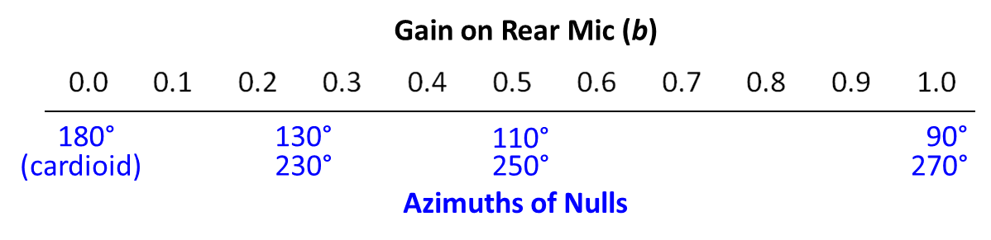
Future Directions: Variable Directionality
Step 2: vary relative gain b on rear cardioid to create different polar patterns with a continuous range of nulls
Bidirectional
b = 1
The front and rear responses add with opposite sign, thereby creating nulls where they intersect
Hypercardioid
Supercardioid
b = 0.5
b = 0.25

Slide 12
Conclusions
Optimized directionality requires precise timing (sampling rate) and microphone matching
Directional patterns and relative AIDI improvements (≈3-4 dB) are consistent with published research
Optimal directivity
Front cardioid obtained with -3 dB gain on the rear mic
Rear cardioid obtained with matched mic gain
Future directions: use optimized front and rear cardioids with opposite phase to vary null with fixed and adaptive directionality

